Slide 1
HALLWAY POSTER SAMPLES
Provided by: Timberlyn Heights Nursing & Rehabilitation

Slide 2
Stay Safe From The Corona Virus and Earn Points
Use the Vampire Sneeze and Cough
tcastine@bearmountainhc.com

Slide 3
Six Tiles Make Smiles
You
Me
That’s 6 Feet Between You and Me
tcastine@bearmountainhc.com

Slide 4
Six Tiles Make Smiles!
Help Keep the Distance!
Great Job Giving Her Space!
How Many Ways Can We Say It?
Thanks for Staying Safe!
Your Facility Name Here
That Mask Looks Great
Thanks for Washing Your
Hands!
Look How Safe You Are Being!
tcastine@bearmountainhc.com

Slide 5
Wear It Right
Right
Wrong
tcastine@bearmountainhc.com

Slide 6
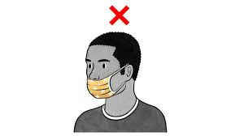
Wear It Right
Right
Wrong

Slide 7
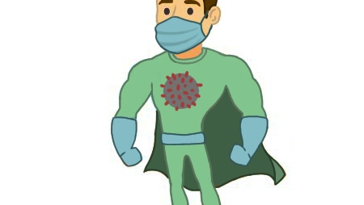
Be a Corona Virus Super- Hero
Wear Your PPE
tcastine@bearmountainhc.com

Slide 8
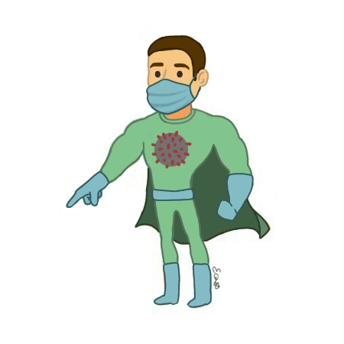
Keep Your Team Safe
Help Others Keep the Distance
Wear Your Mask Correctly
Wash Your Hands
Join Me!
tcastine@bearmountainhc.com

Slide 9
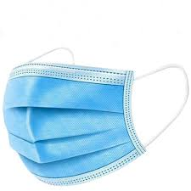
Masks Save Lives And Your Livelihood
Protect Yourself and Those Around You
tcastine@bearmountainhc.com

Slide 10
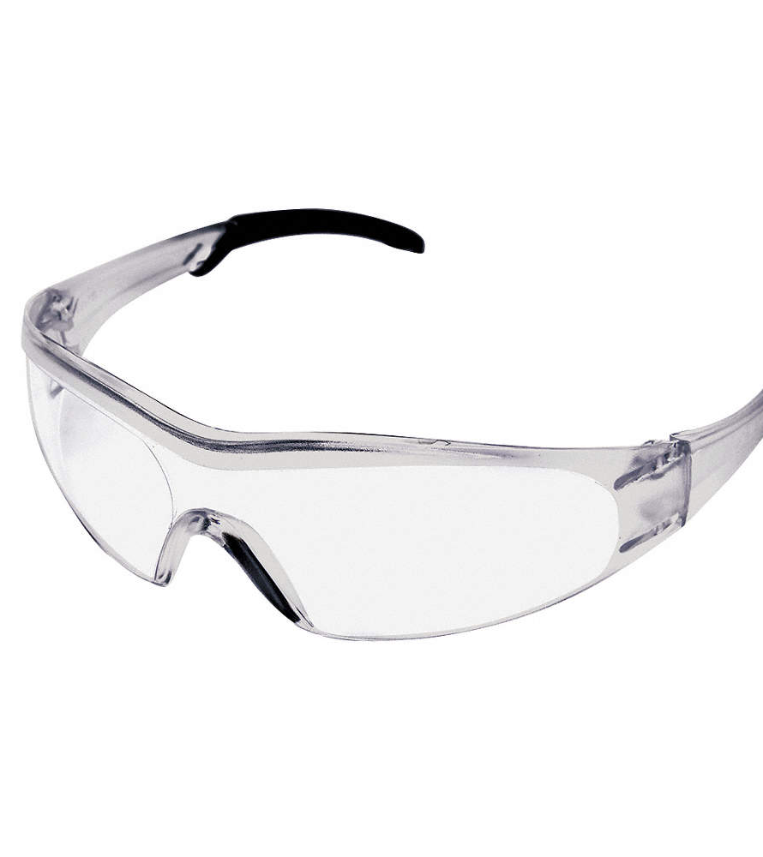
Full - PPE
It Protects
You and Me
tcastine@bearmountainhc.com

Slide 11
Get Caught
Take Part in the Corona Campaign
Maintain Social Distancing
Wear PPE Appropriate for the Task Being Completed
Catch Residents following guidelines and Reinforce
Catch others following exceptional Infection Control Practices
Doing the Right Thing
Part of the Solution
tcastine@bearmountainhc.com

Slide 12
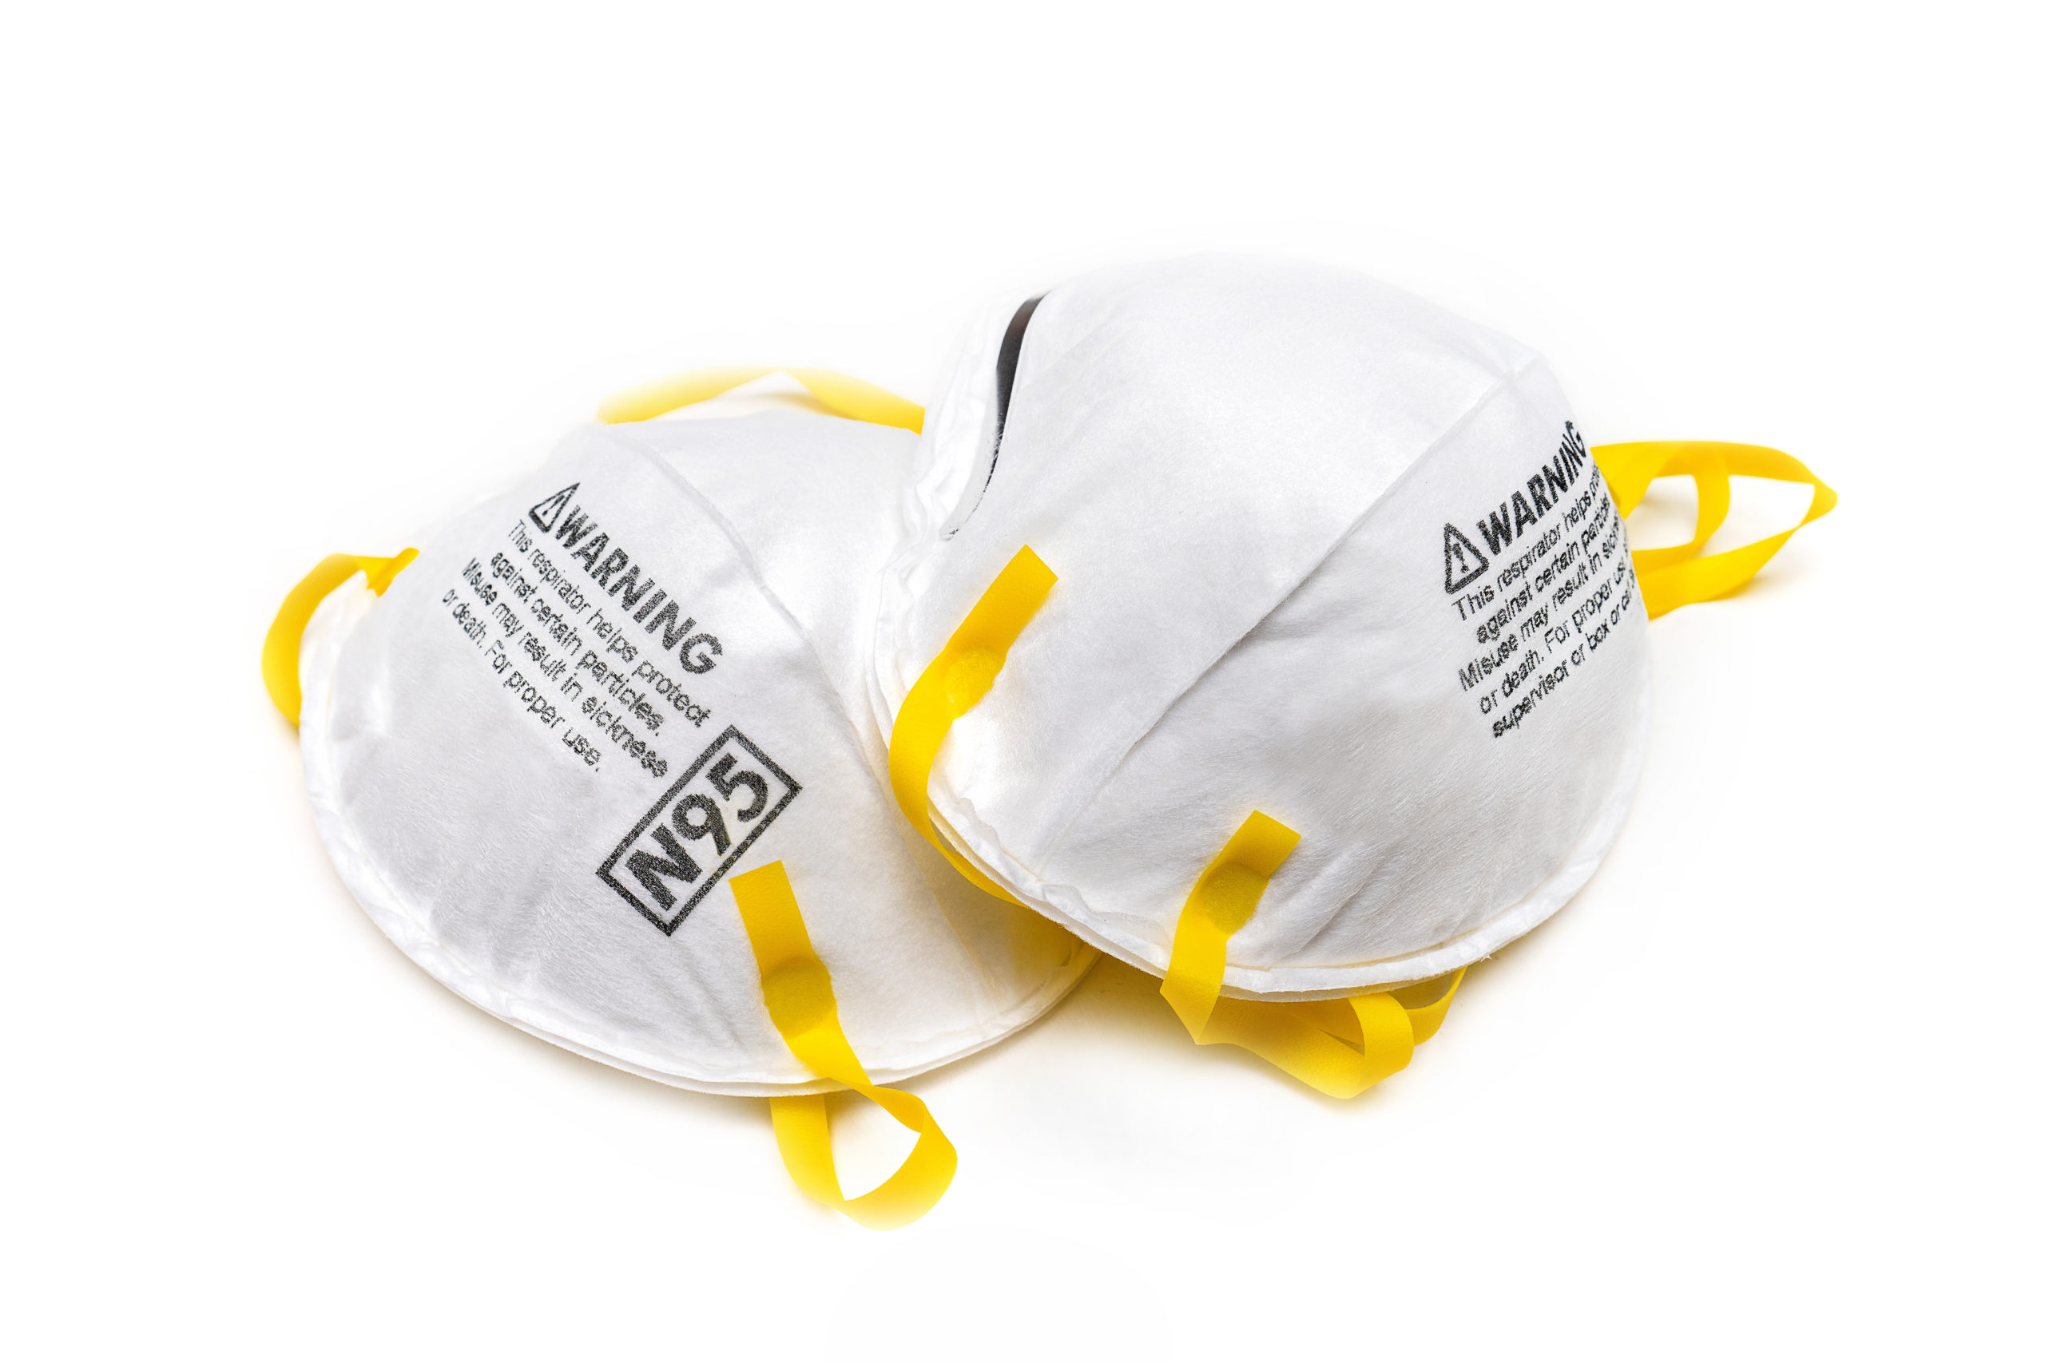
Full - PPE
Droplet Isolation Procedures Required Beyond this Point
tcastine@bearmountainhc.com

